Slide 1


Focus Web Developer
Week 1 - Lesson 1
Notes:
Welcome your class, think about what is the hook to engage your students right out of the starting gate.

Slide 2
ACKNOWLEDGMENT
We walk gently as a guest working on the unceded homelands of
Coast Salish Peoples, the traditional territories of the Squamish, Musqueam and TsleilWaututh First Nations.
We acknowledge the traditional lands of this Nation and it is with gratitude that we now work, learn, and stay here as your guest.
Notes:
*Update slide to insert Nation – ensure that you have the correct spelling and pronunciation as provided by FNTC in your instructor tool kit.

Slide 3
ACKNOWLEDGMENT
We gratefully acknowledge the many Indigenous peoples
that came forward to have their photos taken,
be videotaped, and to share their voices
throughout our curriculum.
“All My Relations”
Notes:
Instructors Note: Let the students know the Indigenous peoples in the photographs are like “actors” woven throughout stories in the curriculum. They are really from the Nations that we have in the stories but we changed the “actors” names and created fictional stories for teaching purposes.
Encourage them to follow the First Nations Technology Council’s social media to learn more about those in the photos, being video taped and that have their voices in the Foundations curriculum.

Slide 4

WELCOME TO YOUR TECH EDUCATION JOURNEY
Notes:
Pictured here are some of our storyboard characters.

Slide 5
ELDER’S WELCOME
Notes:
Reference Elder Glida's bio (located in lesson resources) to introduce her. Students have met Elder Glida in module 1 so you may have the same students. Contact Kim Henderson on Slack to set up a class call with Elder Glida (generally done on Mondays, but the timeline can vary and calls need to be prebooked).
The instructor welcomes students to the class and introduces self, then provides a brief overview of what will be covered over the course of the next two weeks by referencing the syllabus (upload for students from the instructor resources – be sure to update the syllabus first), and some of the skills that students will be walking away with upon successful completion of all activities and assignments, plus the rubric. Note: you will cover this in more detail in slide 7.

Slide 6
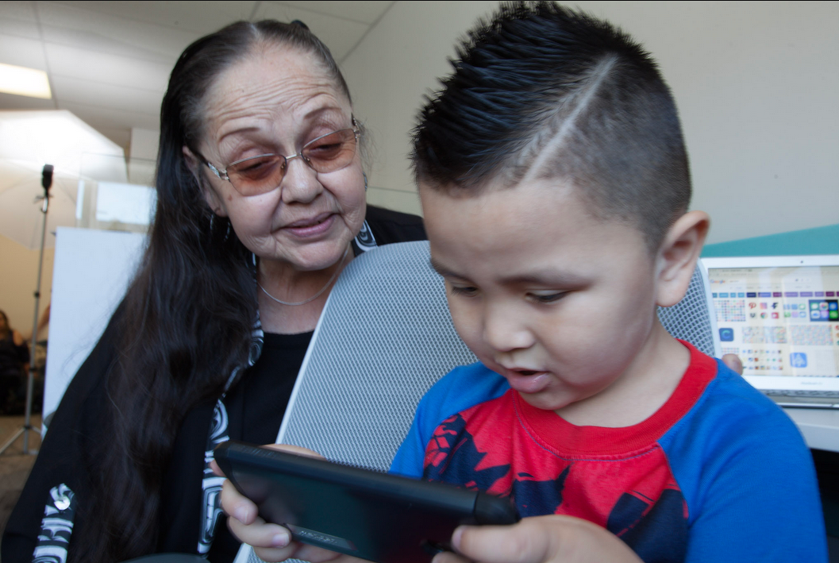
Your First Nations Technology Council (FNTC) Digital Elder Introducing Elder Glida Morgan
Notes:
Reference Elder Glida's bio (located in your instructor folder) to introduce her. Elder Glida is pictured here with her great grandson.
Videos to follow:
Opening Song & sharing: 0 mins- 5:19 mins (slide 6)
Meet Your Digital Elder: 5:20 mins – 6:18 mins (slide 7)

Slide 7
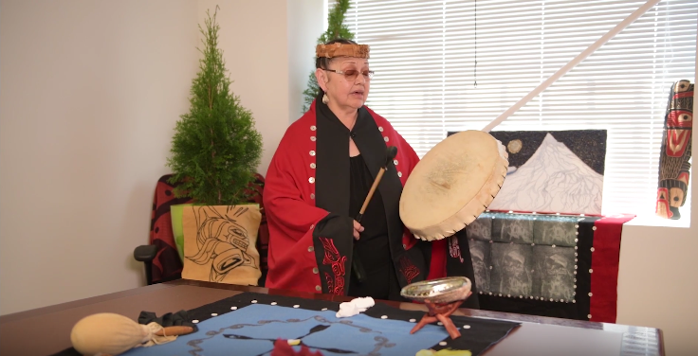
Opening Song
Elder Glida Opening Song
Notes:
https://www.youtube.com/watch?v=nNTCayovFaU
5:20

Slide 8
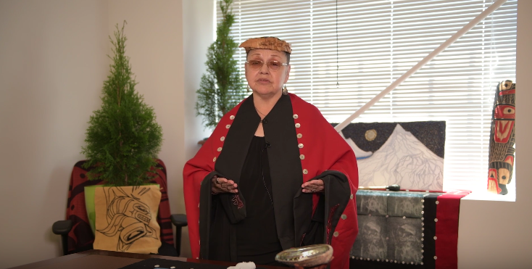
Meet your Digital Elder
Introducing Elder Glida Morgan
Elder Glida Morgan
Notes:
https://www.youtube.com/watch?v=e4EMUZINr-s
1:15

Slide 9
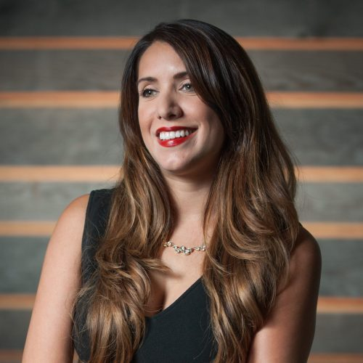
Welcome to Focus Web Developer
By Denise Williams, CEO
Denise Williams, CEO
Notes:
https://www.dropbox.com/home/Technology%20Council%20Shared%20Drive/3000%20-%20Communication%20%26%20Engagement%20Division/3500%20-%20Programs/3520%20-%20Foundations
1:04

Slide 10

Course Description
This course introduces students to the best practices in computer programming, application of advanced computer programming concepts and introduces students to Java Script through the development of 2 projects and a capstone project.
Notes:
Reference syllabus and rubric here in more detail
Students want to know how they will pass, how grading is done, what is expected of them etc. Along with this lesson, upload the syllabus and grading rubric for the students.
Pre-test: always use two way learning. What do the students already know about this subject?

Slide 11

FITC Focus Web Development Learning Outcomes
Apply computer programming best practices, including documentation standards, naming conventions and security
Utilize foundational computer programming concepts to build a simple function
Utilize foundational computer programming concepts to build a simple looping structure
Utilize foundational computer programming concepts to build a simple data structure
Create, access, add to, and delete from array based data structures
Notes:
Upload the course syllabus for the students and review it along with this slide. Review of the syllabus includes course description, learning outcomes, grading, calendar etc. Please note that the capstone replaces the final exam. Replacing final exams with capstones is becoming more and more standard in post secondary education, as it is recognised a better, or equal, way of measuring a students learning and achievement of the course objectives.

Slide 12
Learning Outcomes (con’t)
Select and apply more advanced computer programming concepts to program solutions to common programming challenges
Explain fundamental programming language concepts and describe their purpose within a program
Explain the fundamental concepts of JavaScript and its role in forming the functionality of a website
Identify issues in a program and successfully apply problem-solving techniques to resolve issues

Slide 13
Course Breakdown Unit 1 Programming Fundamentals

Slide 14
Unit 2 Development/Coding

Slide 15
Unit 3 Building/Lab

Slide 16
Gathering Time
Gathering Time is a time for check-in.
Grab a stone, if you have one. Everyone will have an opportunity to speak and to listen.
Notes:
Instructors Notes:
Introduce the concept of Gathering Time, which will be used throughout the program.
A sharing stone can be used by students.
Everyone will listen when the person with the stone talks, so everyone has an opportunity to listen.

Slide 17
Gathering Time
Tell us about you (as much as you are comfortable). Here are some optional questions to help you get started:
your name and your nation
your expectations of this course
your goal after the program has finished
fun fact about you.
*If you don’t want to share just pass the stone to the next person.

Slide 18

Lesson Topics
Schedule
Capstone and Projects Overview
A Brief Introduction to Programming
Programming Paradigms
JavaScript’s Prominence
Problem Domains
JavaScript/HMTL/CSS Intro
Notes:
Pretest – what knowledge do the student’s already have in these areas?
Two-way learning – including the student’s knowledge – how will you champion each student’s knowledge

Slide 19
Capstone Project
JavaScript Programmed Web Application
Notes:
Reference your capstone grading rubric and student instructions in your Instructor folder.

Slide 20

Capstone
You will be building a JavaScript powered Web Application
You will be programming your Web Based Application in JavaScript. HTML and CSS will be used to build the User Interface
Jo

Slide 21
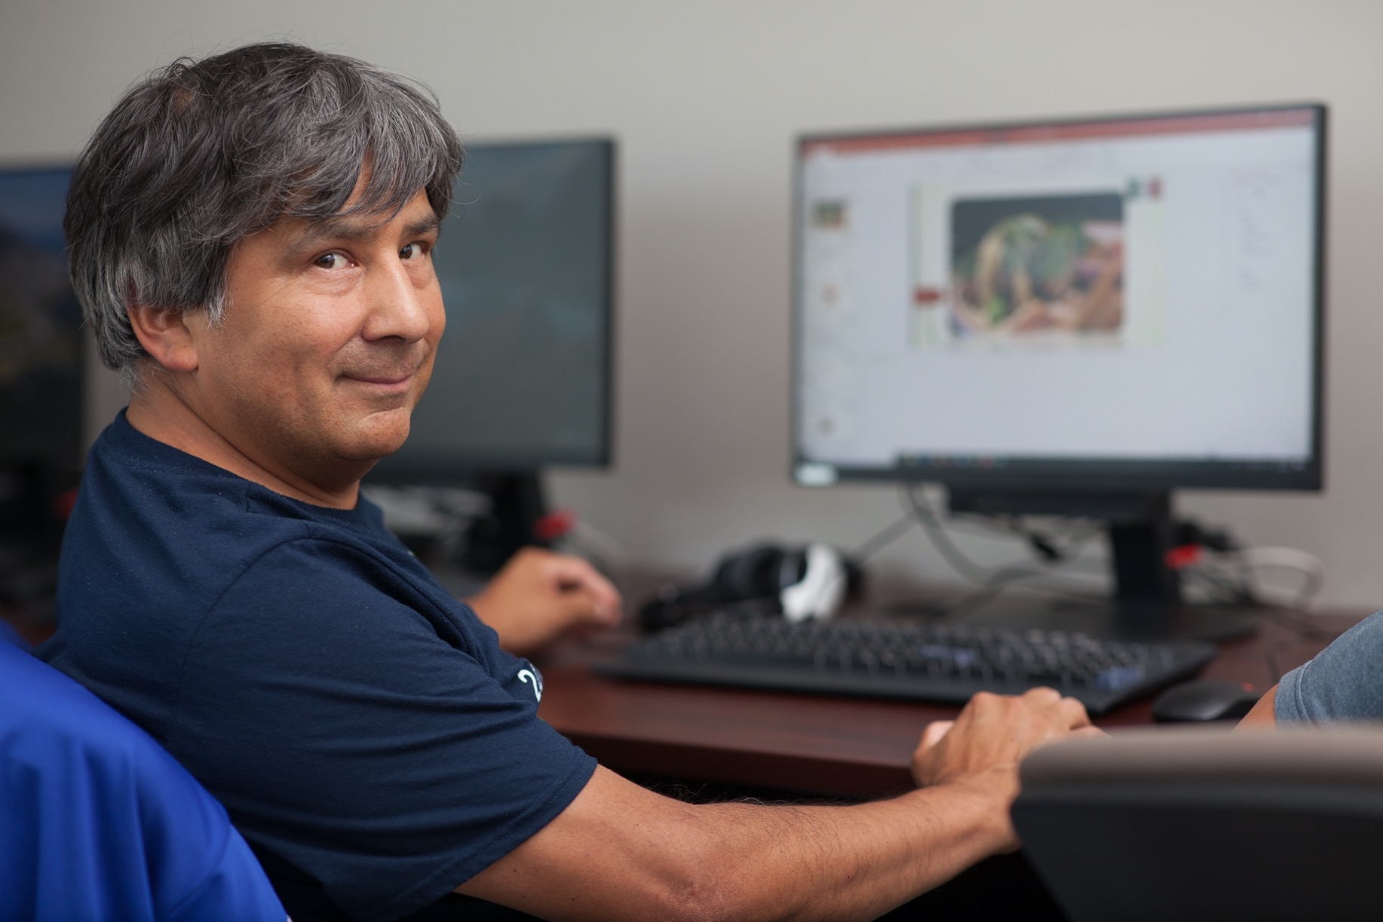
Capstone
You will have the opportunity to work on your application in the last two weeks of the course
On the last day you will be sharing your Web App with the class.
When you present your App to the class, you will be sharing your programming journey with the class.
Dan

Slide 22

Unit Projects
This course is divided into three Units
The First Unit is the Foundations of JavaScript
The Second Unit is Developing with JavaScript
The Third Unit is the Capstone

Slide 23
Unit Projects
Each Unit is two weeks long
Unit 1 and Unit 2 conclude with a Unit Project
Unit 3 is developing, debugging and presenting the final Capstone project

Slide 24
Unit Projects
There will be lab time built into both Unit 1 and Unit 2
The lab time will be your time to work on the Unit Projects
You will present your Unit Projects on the last day of the Unit

Slide 25

Additional Course Information
This is a very hands-on course.
We will start with understanding and reading code - we will write code after developing a good basis of understanding
We encourage you to work in pairs or groups to increase the learning experience.
Learning programming can be a little overwhelming, but just remember to take it a step at a time.
Remember to ask for help when you get stuck.
Jamie(left) & Jo(right)

Slide 26
Assignment 1
Terminology
Notes:
Instructor will have the students set up a file in Word, file name FITC JavaScript_Terminology, save within the FITC XXX folder. Throughout the course, starting today, each time there is a new term or acronym introduced the instructor will have the students add the word(s)/acronyms and their meaning to their terminology file. The instructor will have the same file and build it with the students (on the projector screen) throughout the course. Students will be asked to send the instructor their file on day 10, via private message in Slack.
Rubric Weight 5%
Encourage the students on the value of starting to building their technology vocabulary.

Slide 27
Assignment 1
There are three Units in this course
Assignment 1 – Terminology will be cover all three Units, but the majority of new terminology will likely come up in Units 1 & 2
Aim for 3 terms per day
Notes:
Today the students will start a terminology document. They will add to it each day. Note for students when you want them to add terms, definitions, acronums etc to their terminology assignment. Encourage students to add all terms that they are unfamiliar with.

Slide 28
File Management and Activity Naming
Create one folder per day
Create separate folders for each activity
Activity naming convention:
firstName_lastName_weekNumber_ dayNumber_activityNumber
Notes:
Show the students an example. You may need to review file and folder mgt.

Slide 29
File Management and Activity Naming
main.html
Doe_Jane_1_3_1
styles.css
Day 1
scripts.js
Students will have different files with the same names located in different activity folders
Day 2
Week 1
Day 3
main.html
Week 2
Day 4
Doe_Jane_1_3_2
styles.css
Focus Web
Developer
Week 3
Day 5
scripts.js
Week 4
Week 5
main.html
Week 6
Doe_Jane_1_3_3
styles.css
Activity Naming Convention: firstName_lastName_weekNumber_dayNumber_activityNumber
scripts.js

Slide 30
Welcome to Programming!
Specifically - Welcome to JavaScript Programming!

Slide 31
What is Programming?

Slide 32
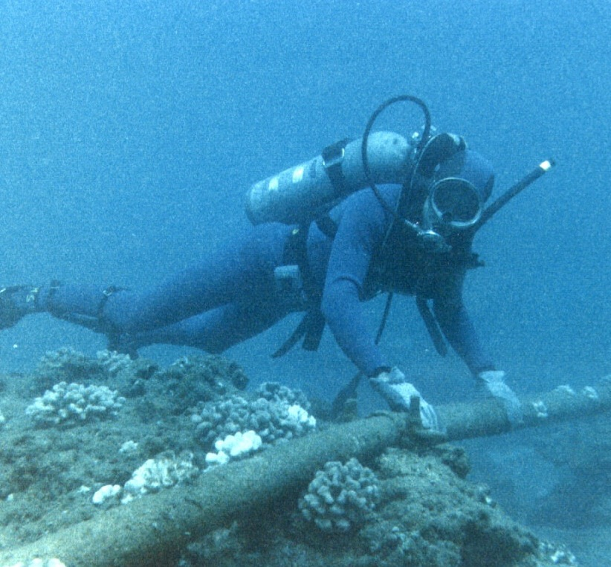
Let’s talk about Programming
We will talk about why JavaScript is a great language to begin with shortly, but right now let’s talk about Programming
Many of you might have a preconception as to what Programming is
Let’s start by examining what Programming means to all of us, and the world in general.
This is not Jo

Slide 33
Programming Background

Slide 34

Discussion
What is Programming?
Sharing your coding knowledge
Notes:
Students will find a partner to work with and discuss the questions:
What is your experience with code?
Have you ever built a website before?
Do you know any programming languages?

Slide 35
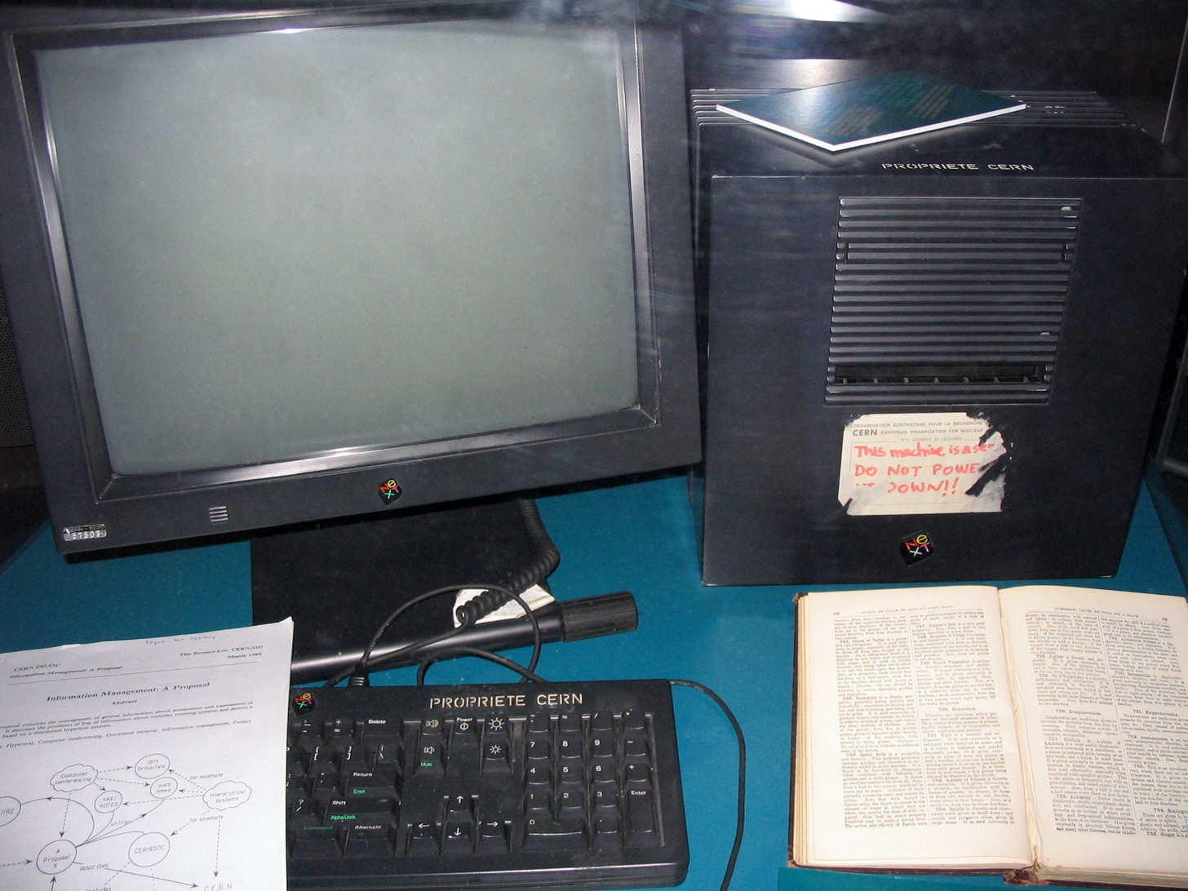
Programming Overview
Programming is manipulating Data
Programming is creating Computer Code that is parsed (interpreted) by a machine (a computer) and gives directives (instructions) to the machine as to how to manipulate data (input)

Slide 36
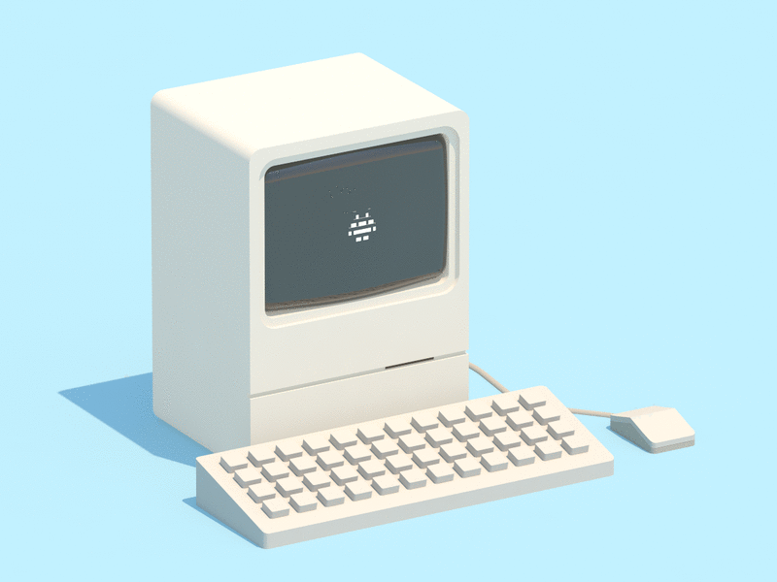
Computer Architecture
When Programming first started it was very difficult to create a program
Different computers have different Architectures
An Architecture is the physical design of a computer

Slide 37
Computer Instructions
Computer Instructions are the instructions that tell a computer what to do
Each different computer Architecture requires a different set of computer Instructions

Slide 38
Instruction Sets
That means that writing a computer program meant writing a different set of computer Instructions for each separate computer Architecture. These are called Instruction Sets.
This created a lot of work for the first programmers.

Slide 39
Instruction Sets
These separate Instruction Sets were written for specific Computer Architectures, and computers do not understand instructions unless they are written in a language that they understand.
Computers understand numbers only, they have no concept of language.
So all these Instruction Sets needed to be written in number based languages.

Slide 40
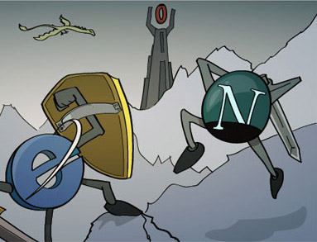
Instruction Sets
A set of instructions could look like this:
00011100
11000000
00010100

Slide 41
Instruction Sets
Actually, more like this:
00011100 00011100 00011100 00011100 00010100 11011100 00011100
11000010 01111100 10001110 01011101 00000100 10000101 00010100
00010100 00011100 00011100 00011100 00011100 01011100 00001100
00010110 10011101 01011101 11011100 11000100 01001100 00010000
11000010 01111100 10001110 01011101 00000100 10000101 00010100

Slide 42

000101
00110101 00111100 11110010
This would probably be very hard to write by hand.
This is called Assembly Language, and the first programmers actually had to learn to write computer instructions this way.

Slide 43

Programming paradigms
A Paradigm is a way of looking at a problem.
In the programming world, when we have a problem that we want to solve, we have some decisions to make before we start to work on the actual programming.

Slide 44
Some of the questions we might ask ourselves are:
What type of problem is this?
Is it number based, like working out a monthly budget?
Is it a word based problem, like a finding specific phrases in a long document?
Is it part of the functionality of mobile app that I’m building?
There are so many possibilities.
Notes:
Have a class discussion on these questions.

Slide 45
Problem Domain
What type of problem is this?
When you figure out the specific problem, this is called in computer science the Problem Domain
What is the exact problem and what type of data is involved (numbers, text, etc).
Notes:
Have a class discussion on these questions.

Slide 46
Discussion
Can you think of a problem that might be solved with programming?
What type of data is involved (numbers, text, etc)?
Defining the Problem Domain
Notes:
Break the students into small discussion groups to discuss these questions. Ask them to share with the larger group after their small group discussion.
Activities are non-graded experiential learning. Students are still required to complete activities.
gs.statcounter.com
The first few activities are required preparation for completing the capstone.

Slide 47

Programming Languages
Why are there so many programming languages?
Notes:
Class discussion

Slide 48
Activity 1
Let’s do a quick research project – individually go on the internet and see how many program languages you can list in the next 10 minutes.
Quick Research Project
Notes:
Students will find a partner to work with and discuss the questions:
What is your experience with code?
Have you ever built a website before?
Do you know any programming languages?

Slide 49
Programming Languages
You might have been baffled by how many programming languages are out there, doing a quick search of the web shows a huge array of languages. It can be confusing.

Slide 50

What Language?
A common first question of beginning programmers is what programming language should I learn?
Notes:
www.justinmind.com/blog/10-90s-websites-designs-you-wont-believe-existed

Slide 51
Activity 2
Let’s quickly research that - what programming language should I first learn?
Create a document that numbers them from 1 - 10
Let’s share with the class your findings.
What Language?
Notes:
gs.statcounter.com
The first few activities are required preparation for completing the capstone.

Slide 52

What Language?
Did you find the same information?
Did different lists show different results?
Notes:
www.smamarketing.net/blog/the-history-of-website-design

Slide 53
Did anyone find JavaScript in that list?

Slide 54






Programming Languages
There are so many computer programming languages because there are so many different types of problems.
All programming languages are developed around Problem Domains.

Slide 55
Program Languages
Most programming languages were created to fix a need - a specific Problem Domain.
R, PHP, C Objective are all examples of Computer Programming Languages that are designed to be used for specific Problem Domains.

Slide 56
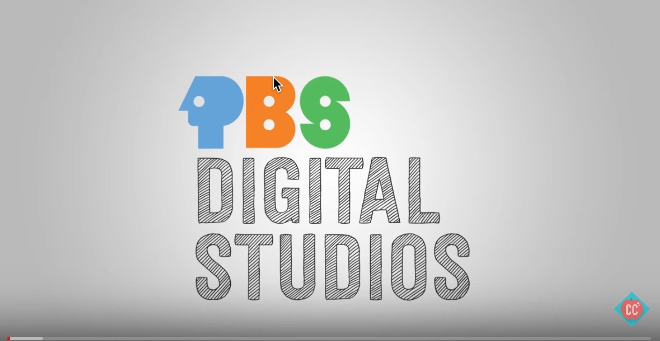
First Programming Languages
The First Programming Languages
Notes:
https://www.youtube.com/watch?v=RU1u-js7db8
11:52

Slide 57
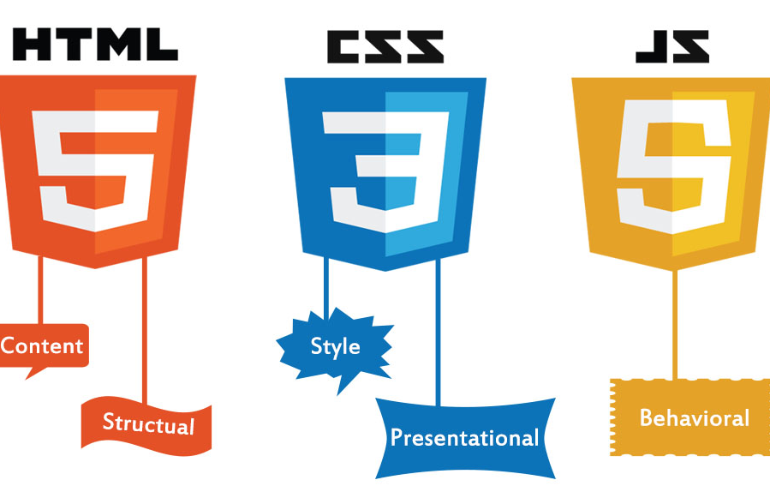
Web Technologies

Slide 58

HTML
Short for Hypertext Markup Language
It is a markup language used for to organizing webpage content
e.g. paragraphs, images, links etc.

Slide 59

CSS
Short for Cascading Style Sheets
A stylesheet language
Used to define the look of a website

Slide 60

JavaScript
Often called JS for short
A programming or scripting language
Used to modify or animate the HTML and CSS of a webpage

Slide 61
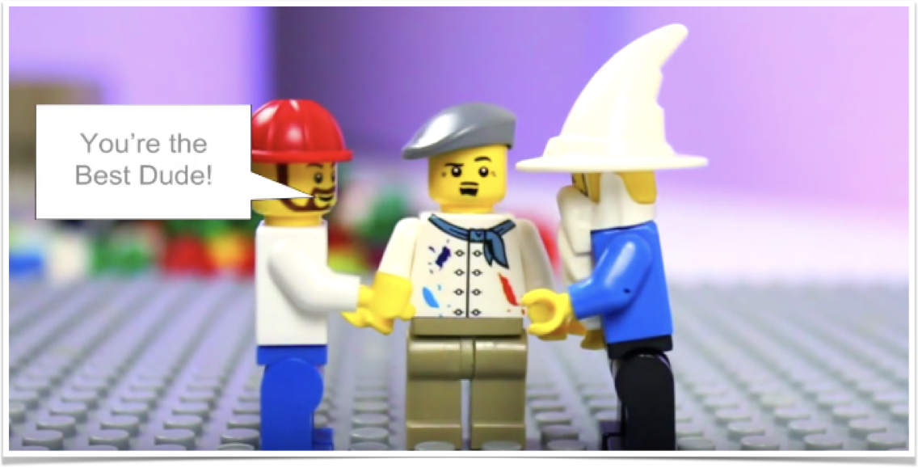
HTML, CSS & JavaScript
HTML, CSS, JavaScript Explained
Notes:
https://www.youtube.com/watch?v=gT0Lh1eYk78
3:57

Slide 62

Class Wrap-Up
Notes:
Instructors Notes:
Students are given feedback on their evaluations of the scenarios, and the instructor emphasises the benefits of being able to apply strategic planning and evaluation in reaching target audiences and retaining their interest. The instructor also emphasises the skills developed by the students through the lesson and explains how these skills will allow the students to address communications and community engagement tasks more easily in their future careers.
End of the day Q/A
Were the day's goals met (reference slide )?
Transition: what’s coming up tomorrow?

Slide 63
Image Credits
Ruby — https://en.wikipedia.org/wiki/Ruby_(programming_language)
PHP — https://www.drupal.org/project/php
https://singularityhub.com/2017/11/19/how-technology-is-leading-us-into-the-imagination-age/#sm.013piyqh19z1f6010pb1y4iqentz1
https://www.doyleqhs.com/the-far-side.html
https://broadbandnow.com/report/apartment-landlords-holding-internet-hostage/

